Slide 1
ENGN6250 /​ COMP6250 Professional Practice 1
Tutorial Week 8 Design Thinking and Analysing Data

Slide 2
Acknowledgement of country
We acknowledge and celebrate the First Australians on whose traditional lands we meet and work, and whose cultures are among the oldest continuing cultures in human history.

Slide 3
Last week (Week 7)
You were able to:
Practice the Design Thinking process to solve your partner’s problem
Apply professional skills when empathising and gathering data
Develop questions for an interview/questionnaire for Professional Project

Slide 4
This week (Week 8)
You will be able to:
Collect data through surveys
Analyse qualitative and quantitative data
Data Presentation
Meet with your team and prepare your professional project

Slide 5
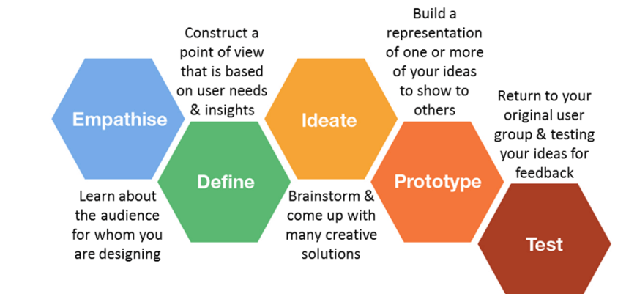
Design Thinking is an iterative cyclic process for innovation

Slide 6
Activity 1/4: Collect data
50 mins

Slide 7

Week 9 Tutorial Preparation
When you collect your data
Consider safety (physical and mental).
Communicate any risks to participants.
Have participants provide informed consent.
Ensure participant responses remain confidential.
Store and manage any data collected ethically.
More info: Listen to Industry Lecture Rod Lamberts on Ethics

Slide 8
Activity 2/4: Data Analysis
30 mins

Slide 9
Analysing qualitative data
Qualitative analysis includes codes, categories and themes
Go through responses from 1-2 questions line by line. Use open or pre-defined codes.
Code individual words, phrases, sentences, chunks, sections.
Include example quotes to explain or justify your coding system.
Code only what relates to your POV.
Compare individual coding systems and example quotes.
Agree on a group approach to coding the data using example quotes to justify your decisions.
Reduce the data and codes into relevant categories and themes.

Slide 10
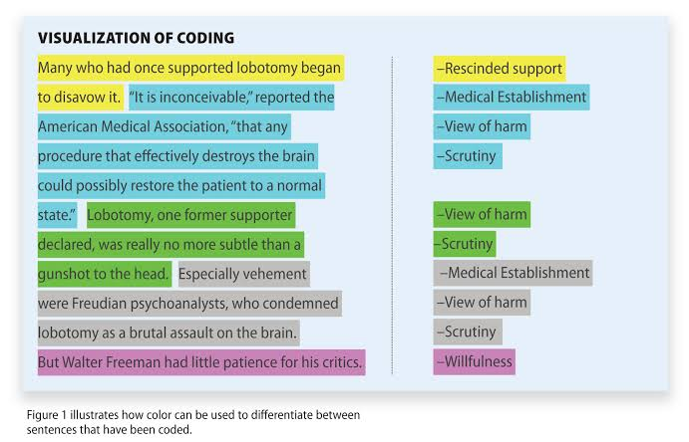
Analysing qualitative data

Slide 11
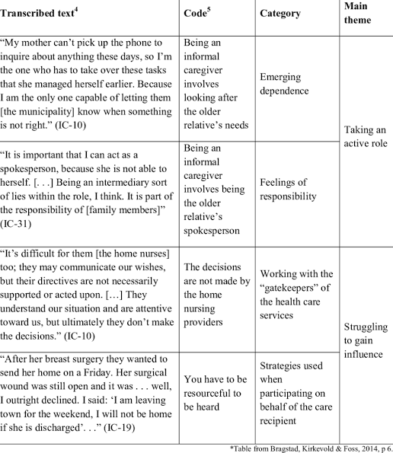

Slide 12
Analysing quantitative data
Quantitative analysis includes statistical analysis using descriptive measures
Calculate the mean, median, frequency, percentage and measures of dispersion for key questions.

Slide 13
Analysing quantitative data
Turn raw numbers into meaningful data through the application of critical thinking…What does the data mean?
Descriptive statistics
is the first level of analysis.
helps to summarise the data and find patterns.
Provide absolute numbers.
Do not explain the reasoning or implications of the numbers.
Helpful when research is limited to a sample and does not need to be generalised to a larger population.
Mostly used for analysing a single variable.
Source: https://humansofdata.atlan.com/2018/09/qualitative-quantitative-data-analysis-methods/

Slide 14
Analysing quantitative data
Descriptive statistics (for example):
Mean: numerical average of a set of values
Median: midpoint of a set of numerical values
Frequency: the number of times a value is found (how often)
Percentage: used to express how a value or group of respondents within the data relates to a larger group of respondents
Measures of Dispersion
Range: the highest and lowest value in a set of values
Deviation: how measurements for a group are spread out from the average (mean), or expected value

Slide 15
Activity 3/4: Presenting data
5 mins

Slide 16
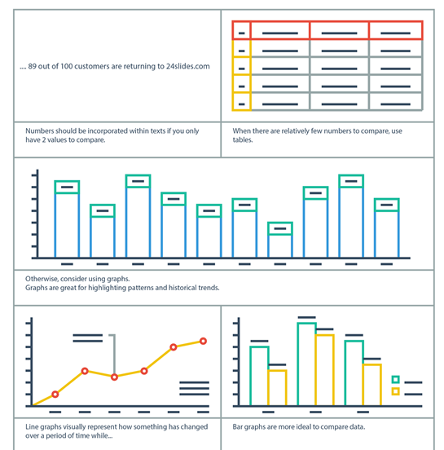
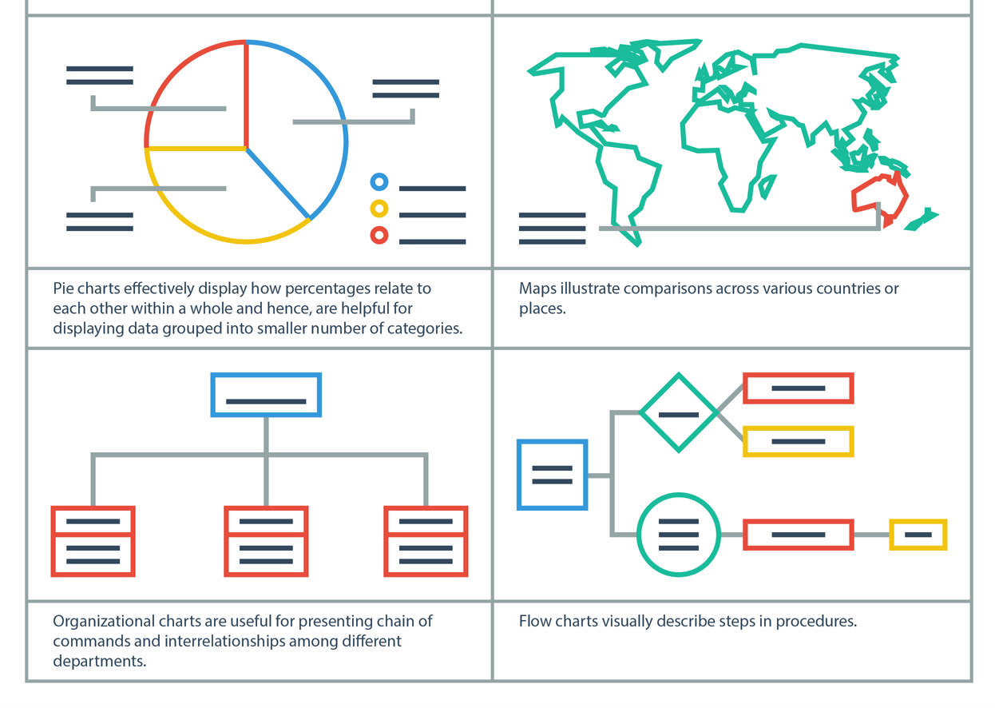
Presenting data

Slide 17
Activity 4/4: Group Work
10 mins

Slide 18
Group Work
Define roles and responsibilities for data analysis
Discuss schedule for team meetings

Slide 19
Looking ahead…Week 9

Slide 20
Week 9
Present main findings and identify their implications
Qualitative findings may include tables or charts.
Quantitative findings may include tables, histograms, other?
Discuss your main findings and their implications in relation to your POV and the topic.

Slide 21
Design Thinking is an iterative cyclic process for innovation

Slide 22
Questions???

Slide 23
Thank you

